Slide 1
Surgical
Scheduling
MIE 1623 Final Project
Linda Hao 1003056541
Pai Peng 1002725394
Liyan Liu 1002896100
Qiaoyi Yan 1003130774

Slide 2
Contents
Problem Statement
Data Overview
Our Approach
Result Analysis
Model Steps &
Collaboration
Problem background, description and our assumptions
Review the current data and perform initial analysis
Determining the goal, the obstacles and our solution
Break down on our 2-steps model to find the solution
Our proposed schedule and discuss the possibility for collaboration

Slide 3

Background
The LHINs
Low Efficiency
Local health integration networks is responsible for health system planning, system funding, and home and community care support in the entire Ontario
LHIN has found that all three hospitals in the OP region routinely experience the highest rate of surgical overtime and cancelation across the province
OP LHINs
Outdated Schedule
A LHIN region Outer Planets consists of three hospitals - Serenity Hospital, Firefly Hospital, and Hands of Blue Hospital, each operates on its own
They suspect the main reason behind their low efficiency were because of their outdated surgical schedules and lack of collaboration between the three hospitals

Slide 4

Problem Description & Assumptions
Problem: To schedule all patients to be operated in time with NO cancelation and LESS overtime.
Regular OR time
Surgeons & Nurses
Maximum Overtime
Optimality vs. Feasibility
For all hospitals, the regular OR room hours is 7-hours from Monday to Friday.
Each hospital has enough surgeons, nurses and equipment to perform any scheduled surgeries in the entire LHIN
All surgeons and nurses will have a maximum of 12-hours shift at any day, therefore the maximum overtime for OR staff per day is 5 hours
Since surgical inefficiency is an ongoing urgent issue LHIN priorities the feasibility and practical value of the solution over its optimality

Slide 5
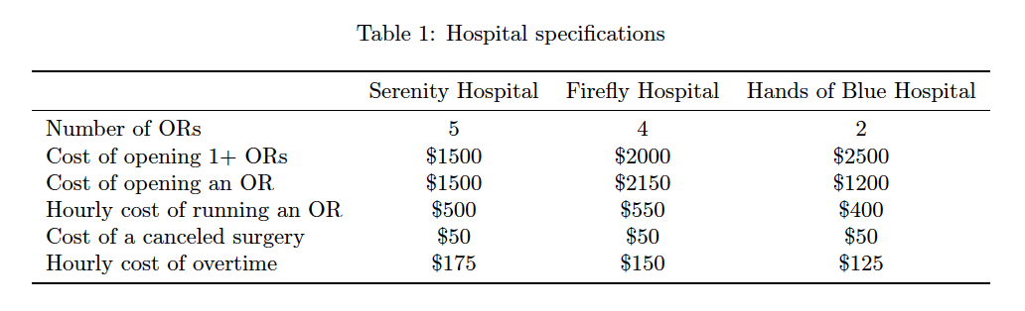

Data Overview – The cost
Fixed Cost
Cost for opening at all
Variable Cost
Cost for opening each OR
Hourly cost for running OR
Hourly cost of overtime
Cost of canceled surgery

Slide 6
Data Overview – Patients
Each Hospital has their own set of patients and available OR rooms.
The patients data include – Patient ID, Estimated OR time and Health status
Investigation and starting point
Below are total workload for each hospital. We have an rough idea of OR rooms needed :
Serenity Hospital need to operate at least 3 OR rooms through the week to fulfill the needs.
2 for Firefly
2 for Hands of Blue
129 Hrs
100 Hrs
61 Hrs
Serenity Hospital
Firefly Hospital
Hands Of Blue
Summed OR Time for Each Hospital

Slide 7
Approaching the problem
The goal : Scheduling patients for each hospital
Optimality matters but not the top concern. The hospitals are expecting feasible solutions that are good and quick to obtain.
The obstacle
Solution space grows exponentially to the size of decision variables.
Serenity Hospital: 59 patients -> 1475 variables !
Solution
Divide and conquer
Splitting the problem into 1) Scheduling patients to hospitals/weekdays
2) Scheduling the patients to OR rooms
Serenity Hospital: 295 +177 = 472 variables !

Slide 8

The model – Step 1
The goal: assigning patients to weekday
Solution by solving following problem:
Min ∑ (overtime + health status term)
s.t. Overtime limit is respected
Decision variable takes integer value
Each patient is assigned once only
Health status term =
A weighted indicator of the sum of health status. The weight grows with weekday.
Essentially, including this term will :
1) Force the model to arrange patients to earlier days as we penalize the later days by having higher weights.
2) Give higher priority to serious condition patients as the health status amplify the cost of being arranged in later weekdays.

Slide 9
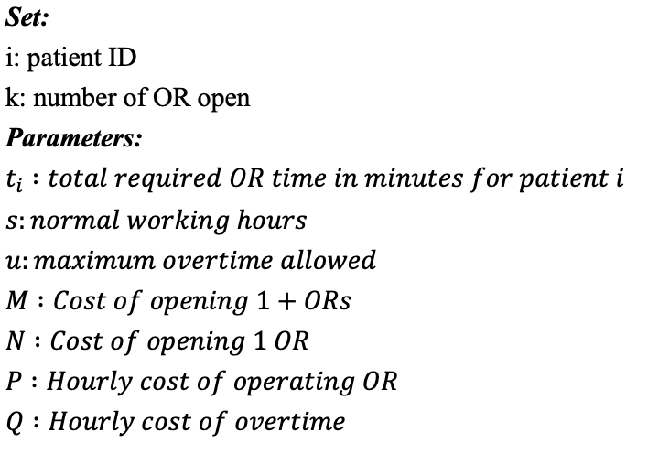
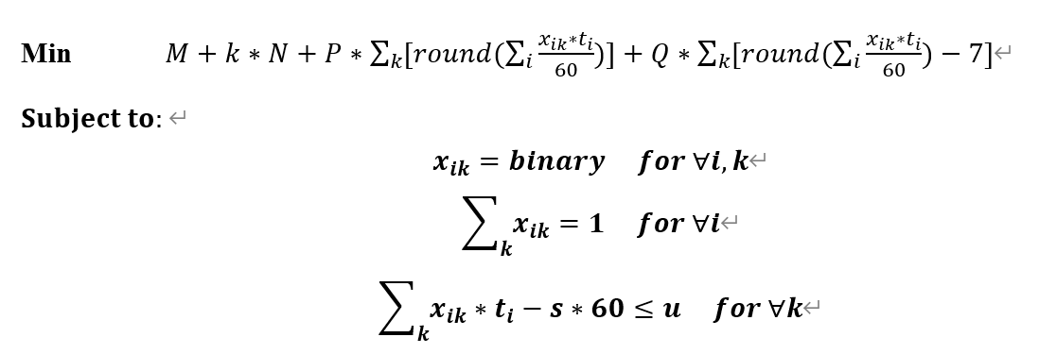
The model – Step 2
The goal: Distribute the patients on each day of the week given the number of OR rooms so that the cost is minimized.
Start with the minimum numbers of OR resulting from previous step
3 for Serenity Hospital, 2 for Firefly Hospital and 2 for Hands Of Blue Hospital
Hospital | Serenity | Firefly | Hands Of Blue
Number of OR Trials | 3,4,5 | 2,3,4 | 2
Solution by solving the mathematical model:

Slide 10
Results
Hospital | Serenity | Firefly | Hands Of Blue | Sum
Number of Patient | 59 | 44 | 29 | 132
Number of OR Opened | 3 | 2 | 2 | 7
Weekly Cost | $99750 | $94650 | $42525 | $236925
Weekly Overtime (hr) | 50 | 25 | 21 | 96

Slide 11

Collaboration
The baseline is that we have the freedom to arrange whoever patient to whichever hospital.
An extra step to assign patients to hospitals.
The assignment to hospital is gained by solving following problem:
Min ∑ weighted working hours
s.t. Decision variable takes integer value
Each patient is assigned once only
Sum of patient OR time does not exceed capacity of Serenity Hospital
Capacity constraint for Firefly Hospital
Capacity constraint for Hands of Blue

Slide 12
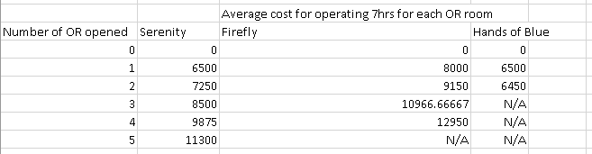
Collaboration
By comparison, Hands of Blue has the least operating cost, followed by Serenity and at last the Firefly.
From cost efficiency aspect, one would select HOB first, then Serenity and lastly the Firefly.
We adapted this greedy algorithm.

Slide 13
Result Comparison
Recommend
Hospital | Serenity | Firefly | Hands Of Blue | Sum
Number of Patient | 81 | 17 | 34 | 132
Number of OR Opened | 5 | 2 | 2 | 9
Weekly Cost | 129450 | 44250 | 54200 | 227900
Weekly Overtime (hr) | 14 | 4 | 4 | 22
Nob-Collaboration Sum
132
7
$236925
96
v.s

Slide 14
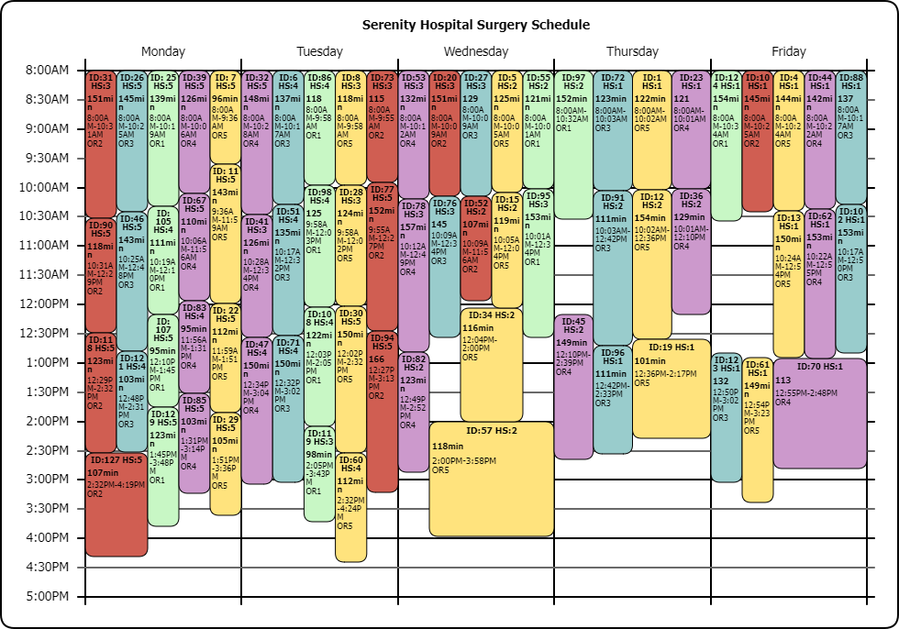
Solution Schedule – Serenity Hospital

Slide 15
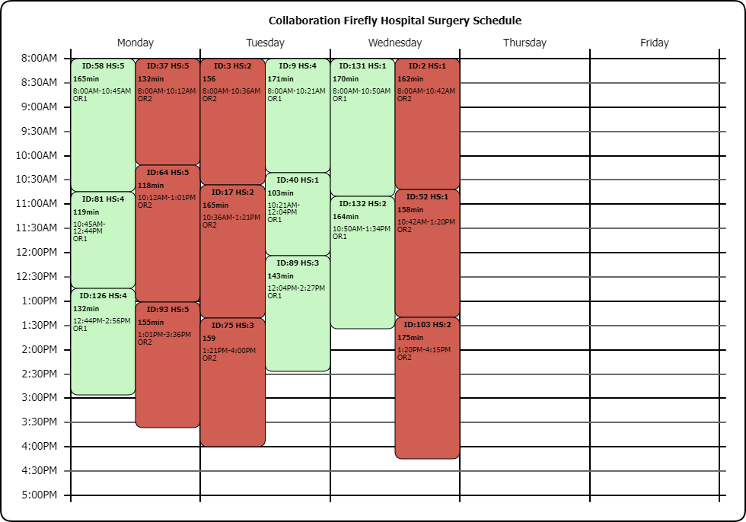
Solution Schedule – Firefly Hospital

Slide 16
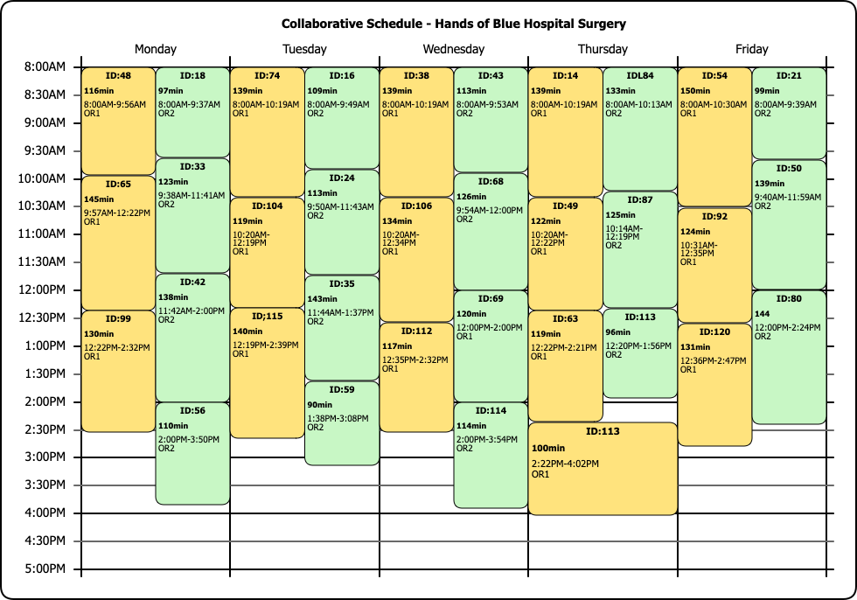
Solution Schedule – Hands of Blue Hospital

Slide 17
Thank you!
MIE 1623 Final Project
University of Toronto
April 6th, 2022

